Slide 1


MediReach: Care Nearby

Slide 2
Problem: Lost Time in Emergencies
Delayed Treatment
Fragmented Information
Need for Unified Solution
Patients waiting for the doctor’s appointment and also waiting for the long time to meet the doctor will be delayed for the treatment during emergency.
Current systems are fragmented, making it difficult to locate the nearest hospital or pharmacy, increasing risk and cost.
A unified solution is needed to outline the process of finding medical facilities and also verifying and searching availability of required medicines whether present in the store or not.

Slide 3
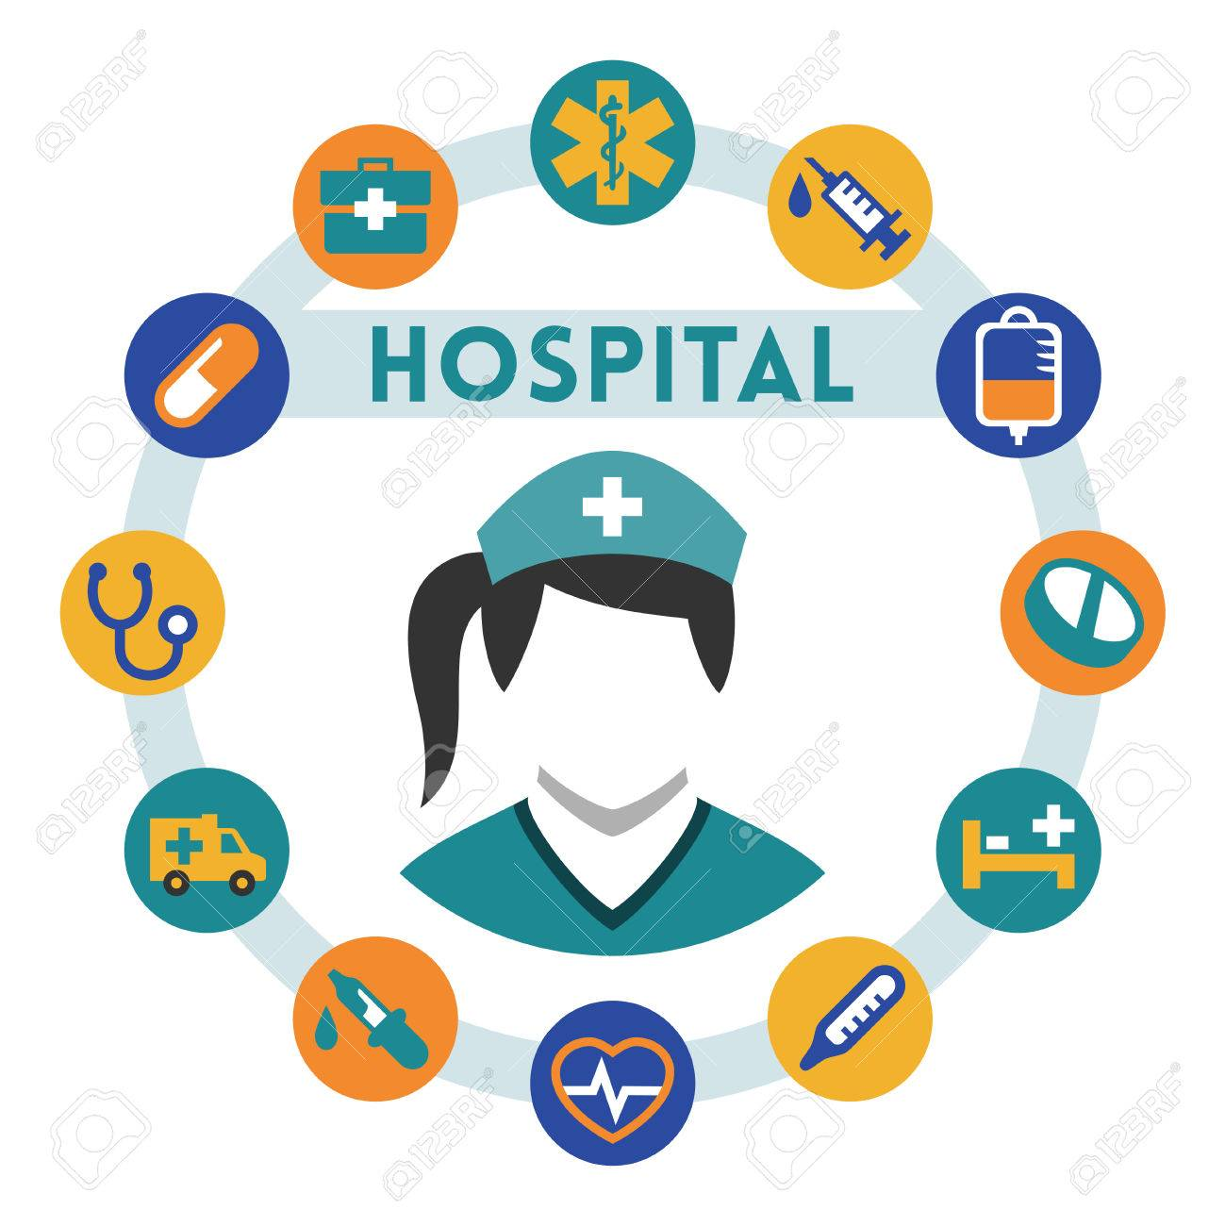
One App Solution
MediReach Overview
MediReach provides the information about the nearby hospitals or clinics or pharmacies and also it provides whether the medicine is available in the nearby store or not provides AI injury advice, and offers symptom-based drug guidance in one tap and also provides the information if accident takes places and a person is injured then if we upload the image then this app excludes all the unrelated hospitals and pharmacies.

Slide 4
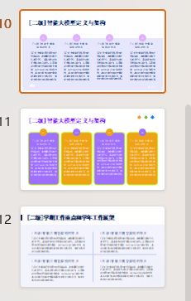
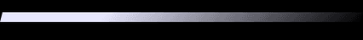
Nearby Facilities Map
Color-Coded Pins
Auto-Location
Facilities are color-coded on the map: hospitals, clinics, and pharmacies are easily distinguishable within a 15 km radius.
Google Maps auto-locates the user, providing a seamless experience by pinpointing their exact location.
Detailed Information
User-Friendly Interface
Each pin displays distance, directions, phone number, ER wait times, and live traffic updates, ensuring users have all necessary information.
The map interface is intuitive, allowing users to quickly find the nearest facilities and navigate to them with ease.

Slide 5
Live Medicine Check
Real-Time Stock Updates
Price and Availability
App queries partner pharmacy APIs to list the stores that currently stock the exact drug, strength, and quantity the user needs and also the uploaded image of injury whether we need to go to the hospital or not and before reaching if we have any precautions it provides the guides before .
Users can see the price and walking time to the nearest pharmacy, ensuring they can quickly access the required medicine in an emergency.

Slide 6
Photo Injury Guide
AI Classification
Image Upload
First-Aid Steps
The model classifies the wound type and severity, providing accurate and timely feedback.
Users can upload an image of their injury for immediate analysis and also it provides the precautions and guidelines and also if it is a minor injury then it provides the useful medication for it.
The app returns first-aid steps, suggests specialists, and lists the three nearest relevant facilities for further care.

Slide 7
Symptom to Drug Match
01
Symptom Input
Users type or pick symptoms, and the engine maps them to appropriate OTC or Rx drugs, ensuring accurate recommendations.
Stock Verification
The app filters results to show only nearby pharmacies that have the required medicine in stock, saving time and effort.
02

Slide 8
Pilot Goals
MediReach will launch in one city, partnering with 50 pharmacies and 10 hospitals to test its functionality and impact.
The goal is to cut search time by 25%, achieve 90% drug availability hits, and gather user feedback for future scaling.
Initial Launch
Target Metrics

Slide 9

Call to Action
Join the Movement
We invite pharmacies and hospitals to join as partners, sharing live stock and ER status. Together, we can transform every phone into a life-saving health navigator within months.

Slide 10

YOUR LOGO
THANK YOU

